Slide 1
CLASSIFICATION OF Flowers
PRESENTATION BY
MADHURYA SHANKAR
- 01JST17IS025

Slide 2
Flower classification is a challenging task due to the wide range of flower species which have similar shape, appearance or surrounding objects such as leaves and grass.
Manual classification is possible but time consuming and tedious to use with a large number of images and potentially erroneous in some flower classes especially when the image background is complex.
Colour, texture, shape, and some statistical information are among the main sources of features that are widely used to identify the different flower species.
The proposed method classifies and recognises flower images using a powerful artificial intelligence tool, convolutional neural networks (CNN).Consequently, system shows the flower name and a short description to user.

Slide 3
Many flower classification techniques rely on learning their features from a segmented flower region to improve accuracy, but Deep learning techniques, especially Convolutional Neural Networks (CNNs), have recently gained wide interest due to superior accuracy compared to classical machine learning methods which rely on hand-crafted features.
Within the past few years, deep learning algorithms particularly Convolutional Neural Networks (CNNs) have proven their much powerful feature representation capabilities in computer vision. Data are trained by using a large set of labelled data with various numbers of layers of the CNN.
CNN is a sub-class of Artificial Neural Network (ANN), an information processing paradigm that is inspired by the way the biological nervous system works, that is how the brain process information.

Slide 4
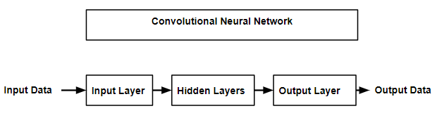
Block Diagram
CNN is comprised of an input layer, an output layer and multiple hidden layers in between. The hidden layers of a CNN mainly consist of convolutional layers, pooling layers, and fully connected layers.

Slide 5
Objectives
To evaluate the current methods used in flower identification.
To divide the dataset into training and testing sets.
To train a convolutional neural network which is capable correctly classifying images of flowers with an average accuracy of 80% or more.
To validate the model and observe the results.

Slide 6
challenges
Creating a flower classification system is a difficult because of large intra-class variation present and small inter-class variation present among different classes .
The dataset of flowers contains the flower images are taken in natural environment where the shine of light changes with the time and weather.
Also, there is a lot more variations in viewpoint, occlusions, scale of flower images.
It requires big data of labelled training images and to prepare this big data, it consumes a lot of time and cost as for the training purpose only.
Non availability of dataset for certain rare species of flowers.

Slide 7
Literature survey
Nilsback and Zisserman [2] designed a flower classification system by extracting visual vocabularies which represent the color, shape, and texture features of flower images.
In order to segment a flower from the background, the RGB color distribution is determined by labelling pixels as foreground and background on a set of training samples, and subsequently the flower is automatically segmented using the concept of interactive graph cuts [3].
Nilsback and Zisserman [2] considered a dataset of 17 species, each containing 80 images, and achieved an accuracy of 71.76% for a combination of all three features. They have achieved an accuracy of 72.8% with an SVM classifier using multiple kernels.

Slide 8
Das et al. [1] proposed an indexing method to index flower patent images using domain knowledge. The flower was segmented using an iterative segmentation algorithm with domain knowledge driven feedback.
In their work, the image color is mapped to names using the ISCC-NBS color system and X Window system. Each flower image is discretized in HSV color space, and each point on the discretized HSV space is mapped to a color name in the ISCC-NBS and X Window systems in order to index the flowers.
Varma and Ray [7] proposed a method for learning the trade-off between invariance and discriminative power for a given classification task.
They learn the optimal, domain-specific kernel as a combination of base kernels corresponding to base features which achieve different levels of trade-off, such as rotation invariance, scale invariance, affine invariance, etc.

Slide 9
Dr. S.M. Mukane et.al [11] proposed Flower Classification Using Neural Network Based Image Processing. In this paper, it is proposed to have a method for classification of flowers using Artificial Neural Network (ANN) classifier.
The proposed method is based on textural features such as Gray level co-occurrence matrix (GLCM) and discrete wavelet transform (DWT).The ANN has been trained by 50 samples to classify 5 classes of flowers and achieved classification. accuracy more than 85% using GLCM features only.
Fadzilah Siraj et al [12] proposed the system for classification of Malaysian blooming flower. In this paper they present the application of NN and on image processing particularly for understanding flower image features.
For predictive analysis, they have used two techniques namely, Neural Network (NN) and Logistic regression. The study shows that NN obtains the higher percentage of accuracy among two techniques.

Slide 10
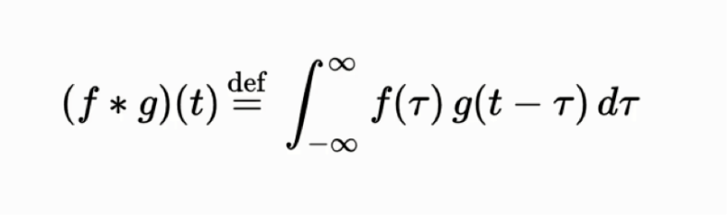
Proposed method
For this project we used a convolutional neural network. This type of network makes use of convolutional layers, pooling layers, ReLU layers, fully connected layers and loss layers.
In a typical CNN architecture, each convolutional layer is followed by a Rectified Linear Unit (ReLU) layer, then a Pooling layer then one or more convolutional layer and finally one or more fully connected layer.
In purely mathematical terms, convolution is a function derived from two given functions by integration which expresses how the shape of one is modified by the other.

Slide 11
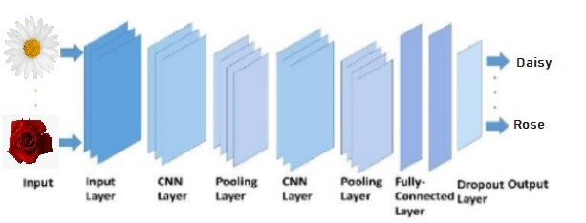
This figure shows a general structure of the proposed CNN based recognition model that includes CNN, subsampling, fully-connected and dropout layers.

Slide 12
A convolutional layer consists of groups of neurons that make up kernels. The kernels have a small size but they always have the same depth as the input.
The strides causes a kernel to skip over pixels in an image and not include them in the output. The strides determines how a convolution operation works with a kernel when a larger image and more complex kernel are used.
As a kernel is sliding the input, it is using the strides parameter to determine how many positions to skip. ReLU layer, or Rectified Linear Units layer, applies the activation function max(0, x). It does not reduce the size of the network, but it increases its nonlinear properties.
Pooling layers are used on one hand to reduce the spatial dimensions of the representation and to reduce the amount of computation done in the network. The other use of pooling layers is to control overfitting.
Fully connected layers are layers from a regular neural network. Each neuron from a fully connected layer is linked to each output of the previous layer.

Slide 13
Experimental analysis
The images above were from the Kaggle’s dataset “Flowers Recognition” by Alexander. The title of each image consists its class name and index number in the dataset. This dataset contains 4242 images of flowers.
All of the images were resized to 150 by 150 pixels to ensure the consistency of the data for the experiment.
The pictures are divided into five classes: daisy, tulip, rose, sunflower and dandelion. For each class there are about 800 photos.
The laptop used to run the CNN for this project was HP Pavilion with Windows 10, Intel Core i7 processor, 8.00 GB RAM and the operating system is 64-bit while the software used is Jupyter notebook.

Slide 14
Layers in Convolutional neural network model
 | Type of Layer | No of Filters | Feature Map Size (Height * Width * Depth) | Kernel Size | No of Stride | No of Padding
 | Image Input Layer | - | 150 x 150 x 3 | - | - | -
1st Convolutional Unit | Conv - 1 (1st Convolutional Layer) | 32 | 150 x 150 x 32 | 5 x 5 | 1 x 1 | 1 x 1
 | Max-Pooling - 1 (1st pooling layer) | 1 | 75 x 75 x 32 | 2 x 2 | - | 0
2nd Convolutional Unit | Conv - 2 (2nd Convolutional Layer) | 64 | 75 x 75 x 64 | 3 x 3 | 1 x 1 | 1 x 1
 | Max-Pooling - 2 (2nd pooling layer) | 1 | 37 x 37 x 64 | 2 x 2 | 2 x 2 | 0
3rd Convolutional Unit | Conv - 3 (3nd Convolutional Layer) | 96 | 37 x 37 x 96 | 3 x 3 | 1 x 1 | 1 x 1
 | Max-Pooling - 3 (3nd pooling layer) | 1 | 18 x 18 x 96 | 2 x 2 | 2 x 2 | 0
4th Convolutional Unit | Conv - 4 (4th Convolutional Layer) | 96 | 18 x 18 x 96 | 3 x 3 | 1 x 1 | 1 x 1
 | Max-Pooling - 4 (4th pooling layer) | 1 | 9 x 9 x 96 | 2 x 2 | 2 x 2 | 0
Fully Connected Unit | Fully Connected Layer | - | 4143749 x 1 | - | - | -

Slide 15
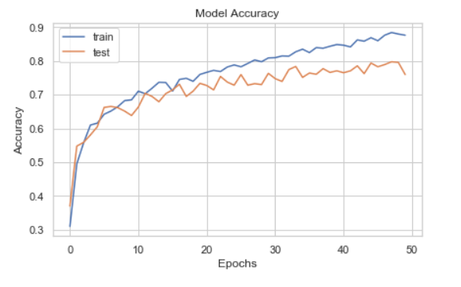
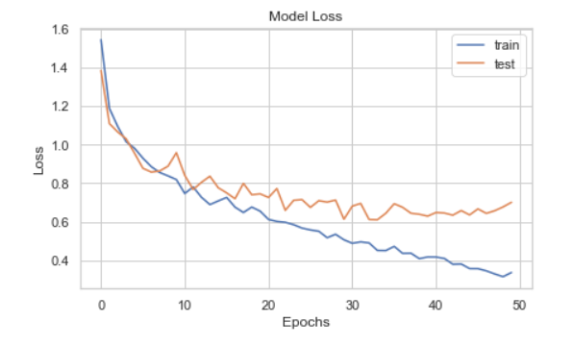
As shown in Figures, the accuracy and loss curves are set to 50 with the training epoch during training. The number of epoch determines the number of repetitions of all the training data .The highest accuracy on test images was found to be 76%, corresponding to a training accuracy 88%.

Slide 16
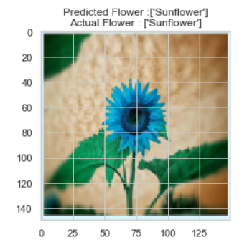
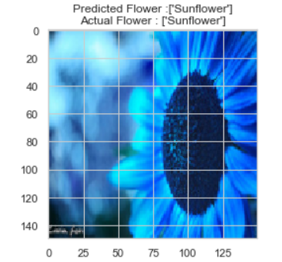
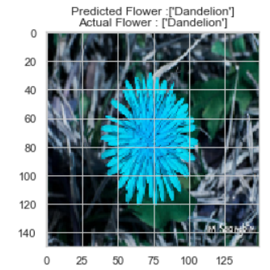
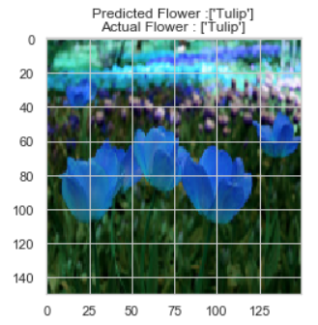
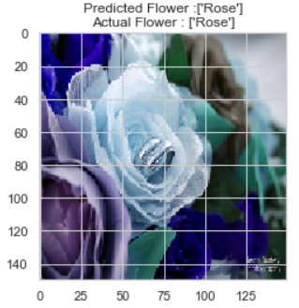
Figures below shows some of the images that were classified correctly.

Slide 17
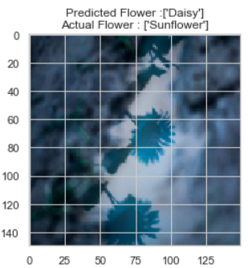
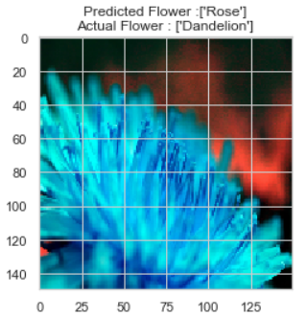
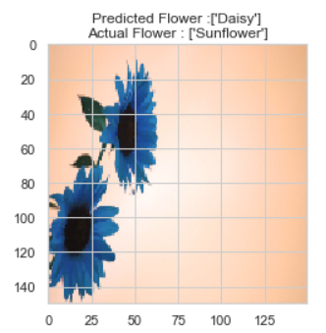
Figures below shows some of the images that were classified incorrectly.

Slide 18
Conclusion and future scope
This project tries to set up a start to an area that is less explored at the current time. During this project we were able to explore part of the deep learning algorithms and discover strengths and weaknesses. We gained knowledge on deep learning and we obtained a software that can recognize flowers from images.
We hope that the results and methods presented in this project can be further expanded in a bigger project. From our point of view one of the main objectives for the future is to improve the accuracy of the neural network.
Another option is to replace all layers with convolutional layers. This has been shown to provide some improvement over the networks that have fully connected layers in their structure.
In the near future we plan to create a mobile application which takes pictures of flowers and labels them accordingly. Another objective is to expand the data set to include more flowers.

Slide 19
references
[1] M. Das, R. Manmatha, E.M. Riseman, Indexing flower patent images using domain knowledge, IEEE Intelligent Systems and their Applications, Volume: 14 Issue: 5 , Sep/Oct 1999,pp. 24-33.
[2] Nilsback Maria-Elena, A. Zisserman, A Visual Vocabulary for Flower Classification, in: CVPR’06: Proceedings of the 2006 IEEE Computer Society Conference on Computer Vision and Pattern Recognition, Volume 2, pp. 1447–1454.
[3] Y.Y. Boykov, M.P. Jolly, Interactive Graph Cuts for Optimal Boundary & Region Segmentation of Objects in N-D Images, in: Eighth IEEE International Conference on Computer Vision, 2001, ICCV 2001, Proceedings, vol. 1, pp. 105–112.
[4] Nilsback M. Elena, Z. Andrew, Automated Flower Classification over a Large Number of Classes, in: ICVGIP’08: Proceedings of the 2008 Sixth Indian Conference on Computer Vision, Graphics and Image Processing, pp. 722–729.
[5] Nilsback Maria-Elena, Z. Andrew, Automated flower classification over a large number of classes, Sixth Indian conference on computer vision, graphics & image processing, 2008. ICVGIP'08, IEEE (2008), pp. 722-729

Slide 20
[6] Y. Yoshioka, H. Iwata, R. Ohsawa, S. Ninomiya Euphytica, Quantitative evaluation of flower colour pattern by image analysis and principal component analysis of Primula sieboldii E.Morren, 139 (2004), pp. 179-186
[7] M. Varma, D. Ray, The NBNN kernel, in: IEEE 11th International Conference, Learning the discriminative power invariance trade-off on Computer Vision, 2007, pp. 1–8. M.
[8] T. Saitoh, K. Aoki, T. Kaneko, in: 17th International Conference on Pattern Recognition, ICPR’04, pp. 27–30.
[9] E.N. Mortensen, W.A. Barrett, Intelligent scissors for image composition in: SIGGRAPH’95: Proceedings of the 22nd Annual Conference on Computer Graphics and Interactive Techniques, September 1995, pp. 191–198.
[10] T. Saitoh, T. Kaneko, in: 15th International Conference on Pattern Recognition, ICPR’00, pp. 507–510.
[11] Dr.S.M.Mukane and Ms.J.A.Kendule, “Flower Classification Using Neural Network Based Image Processing”IOSR-JECE Volume 7, Issue 3,Sep. - Oct. 2013.
[12] Fadzilah Siraj, Muhammad Ashraq Salahuddin and Shahrul Azmi Mohd Yusof, “Digital Image Classification for Malaysan Blooming Flower” IEEE-2010.

